Slide 1
Capstone Engagement
Assessment, Analysis, and Hardening of a Vulnerable System

Slide 2
Table of Contents
This document contains the following sections:
01
Network Topology
02
Red Team: Security Assessment
03
Blue Team: Log Analysis and Attack Characterization
Hardening: Proposed Alarms and Mitigation Strategies
04

Slide 3
Network Topology
‹#›

Slide 4
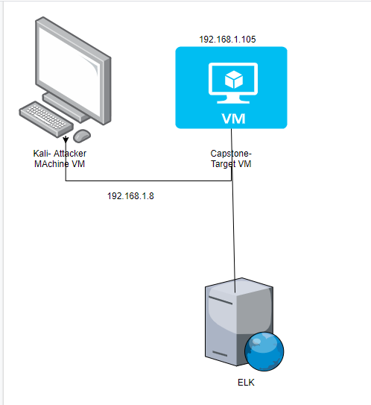
Network Topology
Machines
IPv4:192.168.1.8
OS: Linux
Hostname: Kali
IPv4: 192.168.1.100
OS: Linux
Hostname:ELK
IPv4:192.168.1.105
OS: Linux
Hostname Capstone:

Slide 5

Red Team
Security Assessment
‹#›

Slide 6
Vulnerability Assessment
The assessment uncovered the following critical vulnerabilities in the target:
Vulnerability | Description | Impact
Each of these scenarios are critical, because each of them can lead to an easy attack on a system. | The vulnerability. | What does this vulnerability do?
CRITICAL | The secret_folder is publicly accessible, but contains sensitive data intended only for only someone authorized. As the attacker, i was able to see this folder using just a simple IP address. | This allows an attacker to see sensitive information that can later be used for an attack.
CRITICAL | Users are allowed to upload arbitrary files to the web server such as a php script, which i as the attacker did. | This vulnerability can allow an attacker to upload a malicious php script to a server to later gain access.
CRITICAL | Attackers can use PHP scripts to execute arbitrary shell commands, such as the PHP script i executed into the webDAV folder. | This vulnerability allows an attacker to open a reversal shell to the server to execute an attack

Slide 7
Exploitation: [Name of First Vulnerability]
01
02
03
Tools & Processes
Started off by using nmap to scan the network
-Then proceeded with dirb to map the URLS
Achievements
This exploit allowed me to see that there was a “secret_folder” directory. This folder is password protected and could not be accessed.
Information showed that the folder was for “ashton”

Slide 8
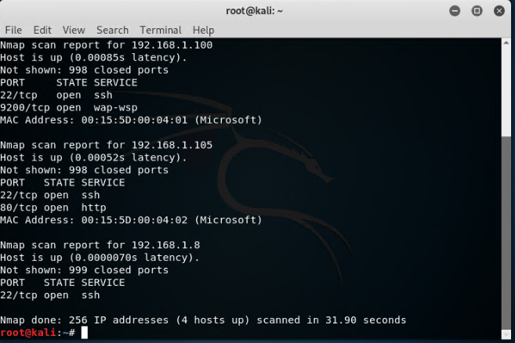
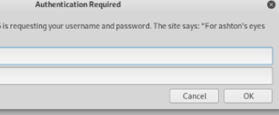
Exploitation: [Name of First Vulnerability]

Slide 9
Exploitation: [Name of Second Vulnerability]
01
02
03
Tools & Processes
Used hydra to crack credentials to gain access to folder
Then used custom msf console to create a web shell
I proceeded with uploading the shell to the webDAV server
Achievements
Uploading the shell allows us to use commands on the target machine from the attacker machine
Screenshots provided next slide.

Slide 10
Cracking Password and MSF console

Slide 11
Exploitation: [Name of Third Vulnerability]
01
02
03
Tools & Processes
Using meterpreter allowed me to connect to the newly uploaded shell
Then, shell can be used to compromise the target machine
Achievements
After using shell, the full system is available to the attacker.
Screenshot is provided on the next page

Slide 12
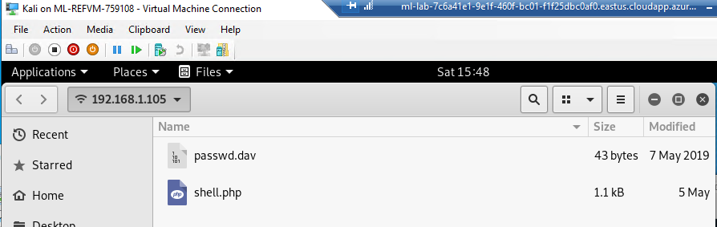

Slide 13

Blue Team
Log Analysis and Attack Characterization
‹#›

Slide 14
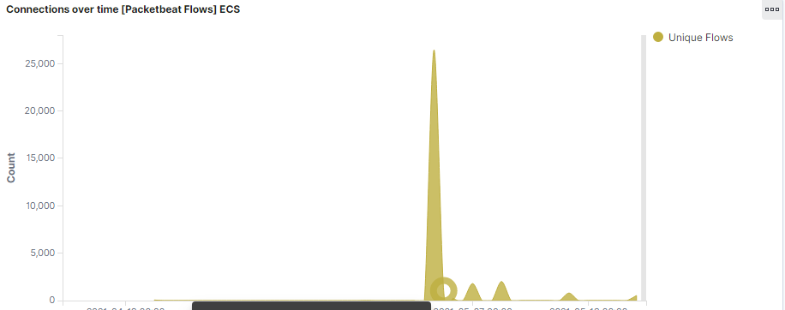

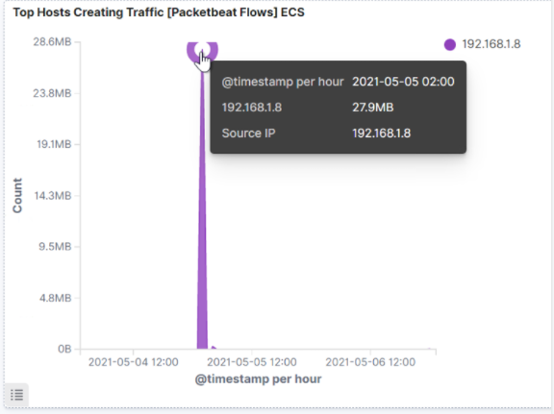
Analysis: Identifying the Port Scan
.
What time did the port scan occur? At 2:00
How many packets were sent, and from which IP?: We can see that there are 1,043 unique flows at the IP 192.168.1.8
What indicates that this was a port scan? The report is sending back 1043 packets which indicates there was a port scan

Slide 15

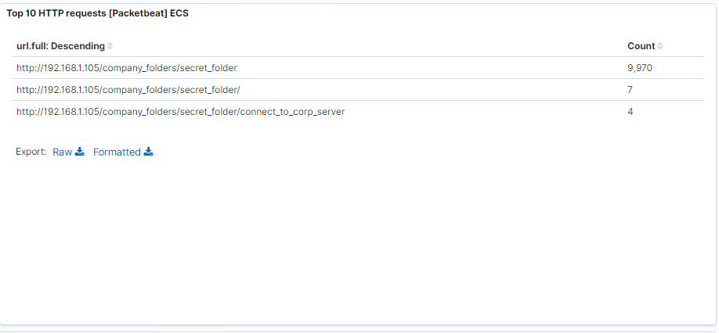
Analysis: Finding the Request for the Hidden Directory
What time did the request occur? How many requests were made?
Which files were requested? What did they contain?
The request occurred at 12:00 midnight (time on my kali machine was a few hours off)
There were 9970 request were made. The files requested the company_folder/secret_folder and also the connect_to_corp_server folder. These contained details for access to the webDAV.

Slide 16
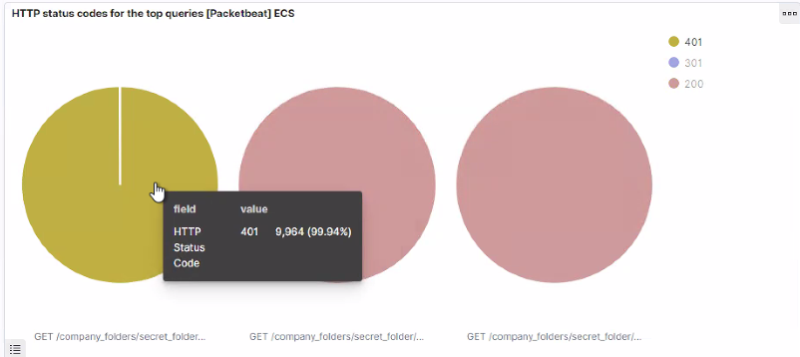
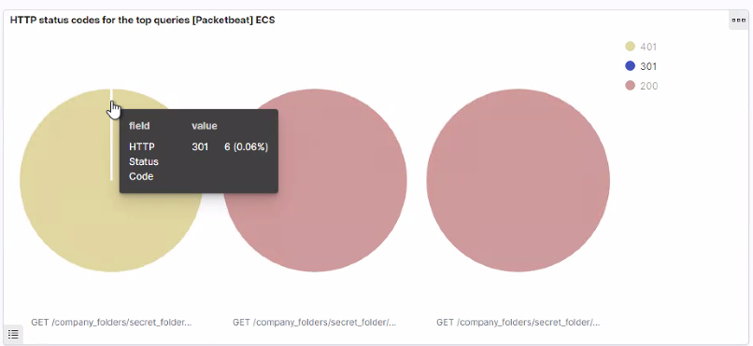
Analysis: Uncovering the Brute Force Attack
Answer the following questions in bullet points under the screenshot if space allows. Otherwise, add the answers to speaker notes.
How many requests were made in the attack?
How many requests had been made before the attacker discovered the password?
[Insert Here]
Include a screenshot of Kibana logs depicting the brute force attack.
There were 9970 requests made in the attack, but the attacker discovered the password around request number 9965. In the first graph, it shows 9964 requests to a failed 401 error, which shows the unsuccessful transactions. The second graph shows 6 successful requests to 301 which redirected the attacker to the webpage with the folders inside. Therefor, at attempt 19965 is when the attacker got the 301 page.

Slide 17
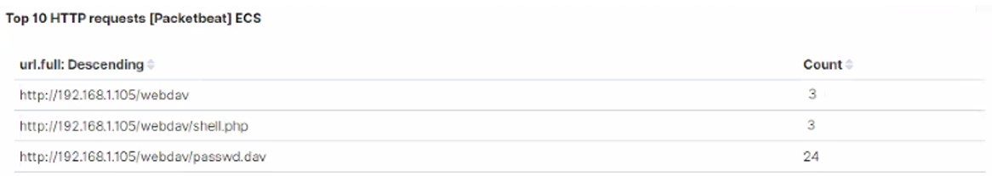
Analysis: Finding the WebDAV Connection
Answer the following questions in bullet points under the screenshot if space allows. Otherwise, add the answers to speaker notes.
How many requests were made to this directory?
Which files were requested?
There were 3 requests made to the webdav directory, and the files requested were the shell.php file and the password.dav. The shell.php was requested 3 times. The passwd.dav was requested a few extra times at 24. Most likely just error on my part for the project as the attacker.

Slide 18
Blue Team
Proposed Alarms and Mitigation Strategies
‹#›

Slide 19
Mitigation: Blocking the Port Scan
What kind of alarm can be set to detect future port scans?
I would set an alarm to trigger when an incoming IP address makes more than a certain amount of HTTP request, per certain amount of Minutes. Another solution would be detecting siem packets in a short amount of time.
What threshold would you set to activate this alarm? A certain threshold would set would be if more than 100 requests are sent within 1 minute
What configurations can be set on the host to mitigate port scans? On the host, you can disable icmp messages to prevent the hacker from knowing the port is closed.
Describe the solution. If possible, provide required command lines. sudo firewall-cmd --zone=public -block-icmp=echo-request -block-icmp=echo-reply

Slide 20
Mitigation: Finding the Request for the Hidden Directory
What kind of alarm can be set to detect future unauthorized access? Anyone outside of the IP address range would be the alarm. A whitelist would be apart of this process.
What threshold would you set to activate this alarm? Whitelist ip addresses only. Anybody that is not on the whitelist IP address can not be let in.
What configuration can be set on the host to block unwanted access?
Whitelist certain IP addresses, therefor if anyone not on the whitelist IP tries to access, we can ban them or not allow them. You can lock specific user agents ( such as hydra)

Slide 21
Mitigation: Preventing Brute Force Attacks
What kind of alarm can be set to detect future brute force attacks? High amount of http 401 requests in a matter of minutes
What threshold would you set to activate this alarm? More than 10 in a matter of a minute. If a system gets more than ten 401 errors in a matter of a minute it should be a clear sign that someone is trying to brute force their way into the system.
What configuration can be set on the host to block brute force attacks?
Blocking the user agents and/or locking the account so they can't try anymore.

Slide 22
Mitigation: Detecting the WebDAV Connection
What kind of alarm can be set to detect future access to this directory?
Set up a whitelist of ip addresses that can accesses the webdav connections.
Monitor the access to the webdav, and use packetbeat, which can monitor the http connection to the server
What threshold would you set to activate this alarm? Send an alarm if someone not on the whitelist ip addresses tries to access the webdav connection
What configuration can be set on the host to control access?
Whitelist certain IP addresses, therefor if anyone not on the whitelist IP tries to access the webDAV, we can ban them or not allow them.

Slide 23
Mitigation: Identifying Reverse Shell Uploads
What kind of alarm can be set to detect future file uploads?
An alarm that disallows any “php” file.
What threshold would you set to activate this alarm? 1 php file should set up the alarm. On this particular website, webDAV, it is a “read me” only scenario, therefor any php file should be alarming.
What configuration can be set on the host to block file uploads?
Telling the developer to disable all file uploads to the websites as this websites does not required it. It is read only purposes.
Put a WAF to block all unnecessary port

